Slide 1
Spring Web Development

Slide 2
Objectives
Building web applications using the Spring Framework.
Spring MVC (Model-View-Controller)
Spring WebFlux
Spring Boot
RESTful Web Services
Security
Integration with other technologies
Understand a modern server-side Java template engine for both web and standalone environments, capable of processing HTML, XML, JavaScript, CSS and even plain text (Thymeleaf)

Slide 3
Spring Web Development Introduction
The Spring Framework offers a robust and flexible platform for developing web applications, with comprehensive support for integration, scalability, security, and testing.
With Spring Framework, a strong community support and alignment with modern architectural patterns make it a compelling choice for building modern and reliable web applications.

Slide 4
Spring Web Development Introduction
Spring provides a comprehensive and flexible platform for building web applications, whether you're using traditional MVC patterns or adopting newer reactive programming paradigms.
Spring MVC (Model-View-Controller)
Spring WebFlux
Spring Boot
RESTful Web Services
Security
Integration with other technologies
Testing

Slide 5

Spring MVC (Model-View-Controller)
Spring MVC is the traditional approach to building web applications with Spring.
It provides a robust architecture for organizing your web application into components such as controllers, views, and models.
Controllers handle incoming requests, models represent the data, and views render the response.

Slide 6

Spring WebFlux
Spring WebFlux is the reactive approach introduced in Spring 5.
It's based on Project Reactor and the Reactive Streams specification.
WebFlux allows you to build non-blocking, reactive web applications, which are particularly useful for handling high concurrency and streaming data scenarios.
The reactive-stack web framework, Spring WebFlux is fully non-blocking, supports Reactive Streams (https://www.reactive-streams.org/) back pressure, and runs on such servers as Netty, Undertow, and Servlet containers.

Slide 7

Spring Boot
While not exclusively for web development, Spring Boot greatly simplifies the process of creating stand-alone, production-grade Spring-based applications.
Consider using Spring Boot to quickly bootstrap your Spring applications.
Spring Boot offers a convention-over-configuration approach, simplifying the setup and configuration of Spring-based applications.
Spring Boot is an excellent choice for rapidly developing web applications with minimal setup and boilerplate code.

Slide 8

Spring Security
Security: Spring Security is the de facto standard for securing Spring-based applications.
It provides comprehensive security features for web applications, including authentication, authorization, session management, and more.
It supports both traditional server-rendered applications (like Spring MVC) and modern single-page applications (like those built with Angular or React).

Slide 9
Spring REST
If your web applications require RESTful services, consider using Spring's support for building REST APIs.
Spring's REST capabilities, combined with Spring MVC or Spring WebFlux, provide powerful tools for creating and consuming RESTful services.
Spring MVC and Spring WebFlux can both be used to create RESTful services, with features like content negotiation, request mapping, and input validation.

Slide 10
Integration with other technologies
Spring integrates seamlessly with other technologies commonly used in web development, such as databases (via Spring Data), messaging systems (via Spring Messaging), and frontend frameworks (via RESTful APIs or WebSocket support).

Slide 11
Spring Data
For data access, Spring Data offers a range of options, including JPA, MongoDB, Redis, and more.
Choose the appropriate Spring Data module based on your data storage requirements to simplify data access and manipulation within your web applications.

Slide 12
Templating engines
When it comes to templating engines, consider using Thymeleaf or Freemaker.
Both provide powerful template processing capabilities, enabling the seamless integration of dynamic content into web pages.
Thymeleaf, in particular, is a popular choice for Spring-based web applications due to its natural integration with Spring MVC.

Slide 13
Thymeleaf - a Java-based server side template engine

Slide 14
What is Thymeleaf?
Thymeleaf is a modern server-side Java template engine for both web and standalone environments, capable of processing HTML, XML, JavaScript, CSS and even plain text.
The main goal of Thymeleaf is to provide an elegant and highly-maintainable way of creating templates.
Thymeleaf improves communication of design and bridges the gap between design and development teams.
Thymeleaf has also been designed from the beginning with Web Standards in mind - especially HTML5 - allowing you to create fully validating templates if
that is a need for you
Notes:
https://www.thymeleaf.org/doc/tutorials/3.1/usingthymeleaf.pdf

Slide 15
Kinds of templates in Thymeleaf
There are two markup template modes (HTML and XML), three textual template modes (TEXT , JAVASCRIPT and CSS) and a no-op template mode (RAW).
The HTML template mode will allow any kind of HTML input, including HTML5, HTML 4 and XHTML. No validation or well-formedness check will be performed, and template code/structure will be respected to the biggest possible extent in output.
The XML template mode will allow XML input. In this case, code is expected to be well-formed – no unclosed tags, no unquoted attributes, etc – and the parser will throw exceptions if well-formedness violations are found. Note that no validation (against a DTD or XML Schema) will be performed.

Slide 16
Kinds of templates in Thymeleaf
The TEXT template mode will allow the use of a special syntax for templates of a non-markup nature. Examples of such templates might be text emails or templated documentation. Note that HTML or XML templates can be also processed as TEXT , in which case they will not be parsed as markup, and every tag, DOCTYPE, comment, etc, will be treated as mere text.
The JAVASCRIPT template mode will allow the processing of JavaScript files in a Thymeleaf application. This means being able to use model data inside JavaScript files in the same way it can be done in HTML files, but with JavaScript-specific integrations such as specialized escaping or natural scripting. The JAVASCRIPT template mode is considered a textual mode and therefore uses the same special syntax as the TEXT template mode.

Slide 17
Kinds of templates in Thymeleaf
The CSS template mode will allow the processing of CSS files involved in a Thymeleaf application. Similar to the JAVASCRIPT mode, the CSS template mode is also a textual mode and uses the special processing syntax from the TEXT template mode.
The RAW template mode will simply not process templates at all. It is meant to be used for inserting untouched resources (files, URL responses, etc.) into the templates being processed. For example, external, uncontrolled resources in HTML format could be included into application templates, safely knowing that any Thymeleaf code that these resources might include will not be executed.

Slide 18
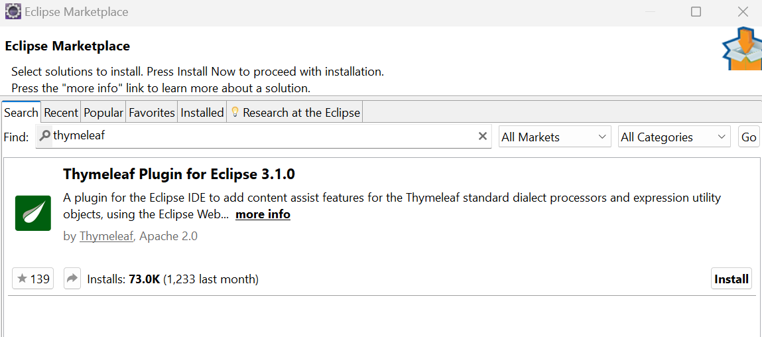
Install Thymeleaf Plugin for Eclipse

Slide 19
Standard Expression Syntax
Simple expressions:
Variable Expressions: ${...}
Selection Variable Expressions: *{...}
Message Expressions: #{...}
Link URL Expressions: @{...}
Fragment Expressions: ~{...}
Literals
Text literals: 'one text' , 'Another one!' ,…
Number literals: 0 , 34 , 3.0 , 12.3 ,…
Boolean literals: true , false
Null literal: null
Literal tokens: one , sometext , main ,…

Slide 20
Standard Expression Syntax
Text operations:
String concatenation: +
Literal substitutions: |The name is ${name}|
Arithmetic operations:
Binary operators: + , - , * , / , %
Minus sign (unary operator): -
Boolean operations:
Binary operators: and , or
Boolean negation (unary operator): ! , not

Slide 21
Standard Expression Syntax
Comparisons and equality:
Comparators: > , < , >= , <= ( gt , lt , ge , le )
Equality operators: == , != ( eq , ne )
Conditional operators:
If-then: (if) ? (then)
If-then-else: (if) ? (then) : (else)
Default: (value) ?: (defaultvalue)
Special tokens:
No-Operation: _

Slide 22
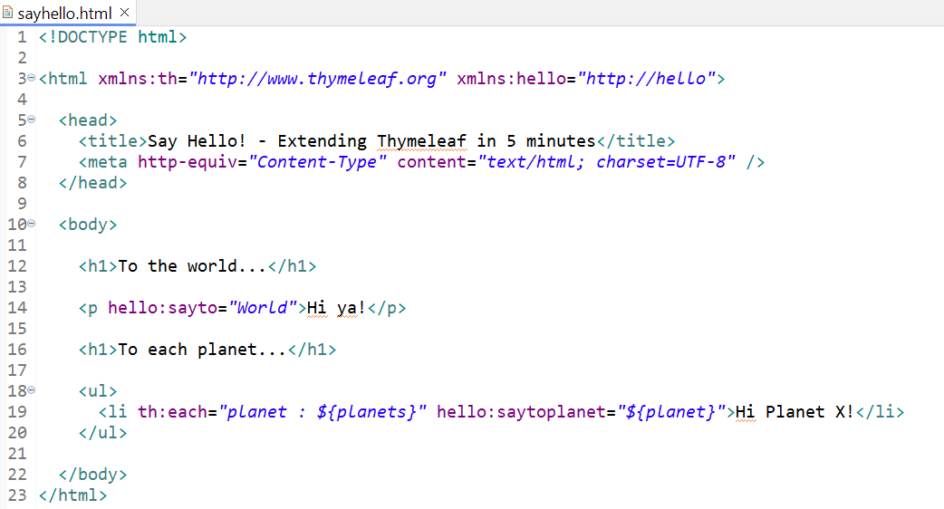
HTML Template Example

Slide 23
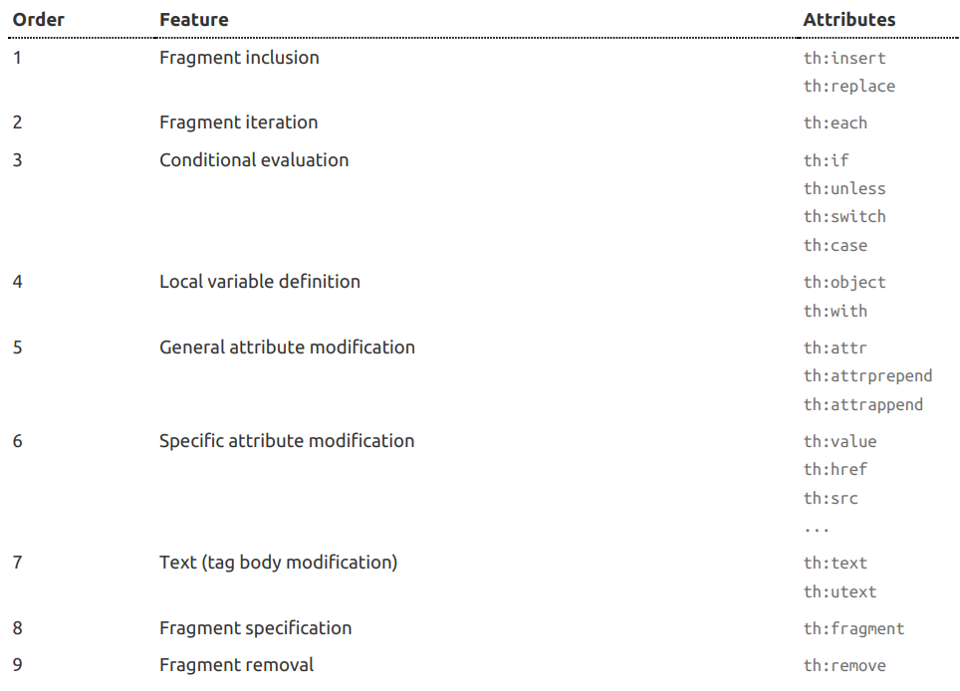
Attribute Precedence

Slide 24
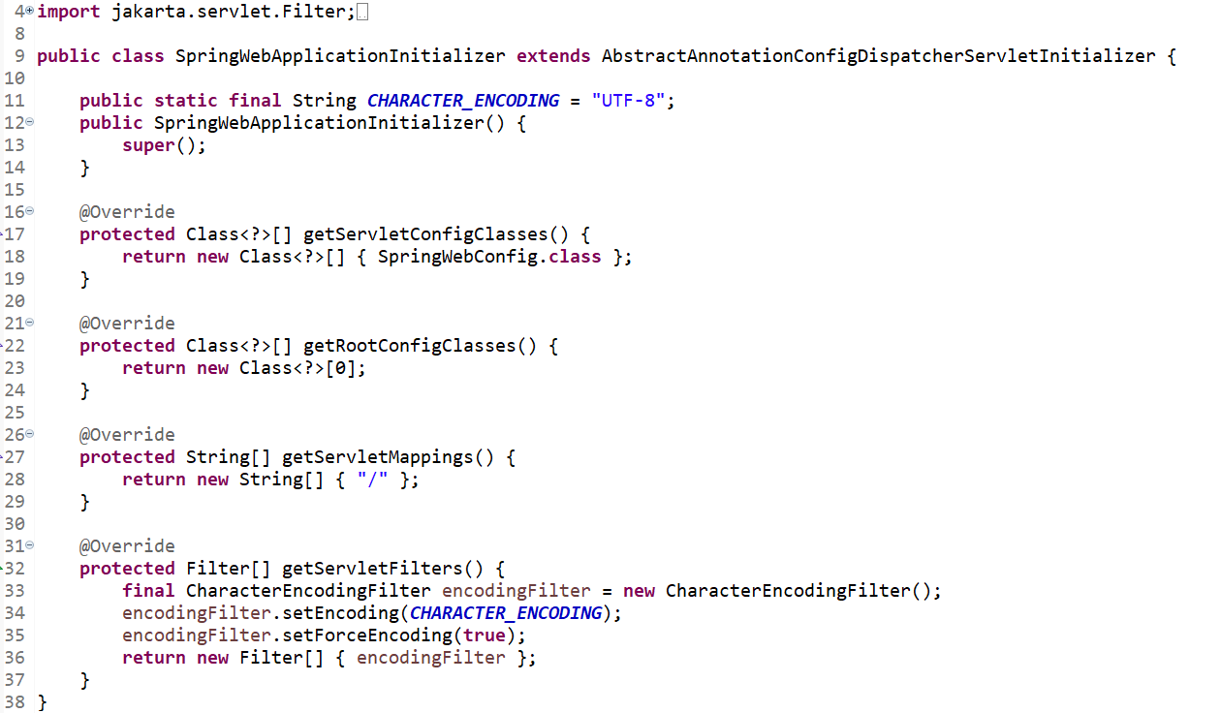
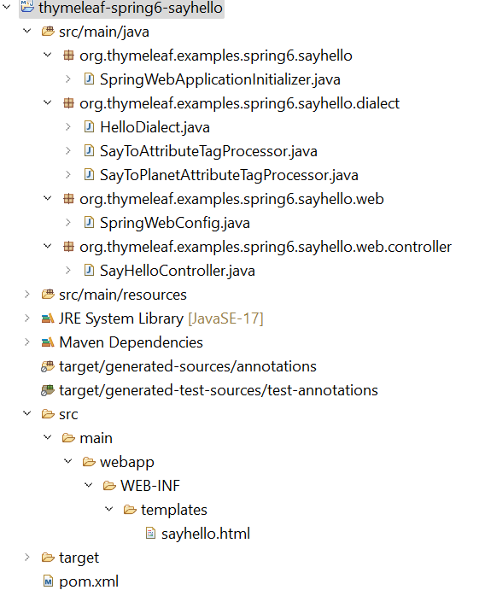
Create a simple project using Thymeleaf

Slide 25
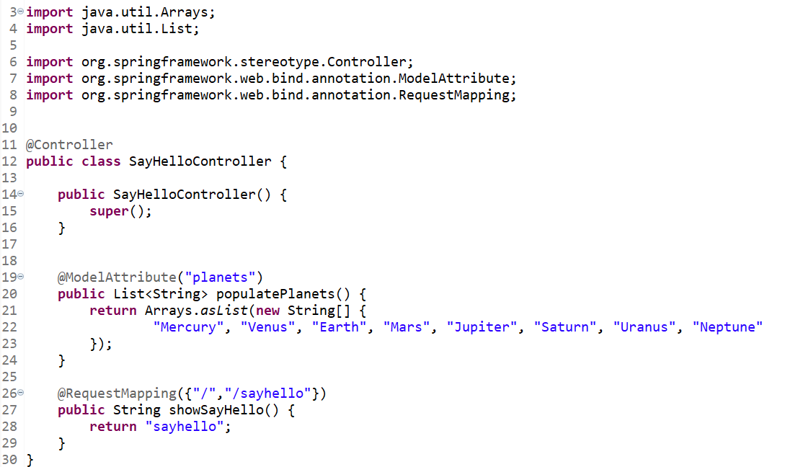
Controller

Slide 26
The Standard Dialect
Thymeleaf is an extremely extensible template engine (in fact it could be called a template engine framework) that allows you to define and customize the way your templates will be processed to a fine level of detail.
An object that applies some logic to a markup artifact (a tag, some text, a comment, or a mere placeholder if templates are not markup) is called a processor, and a set of these processors – plus perhaps some extra artifacts – is what a dialect is normally comprised of.
Out of the box, Thymeleaf’s core library provides a dialect called the Standard Dialect, which should be enough for most users.

Slide 27
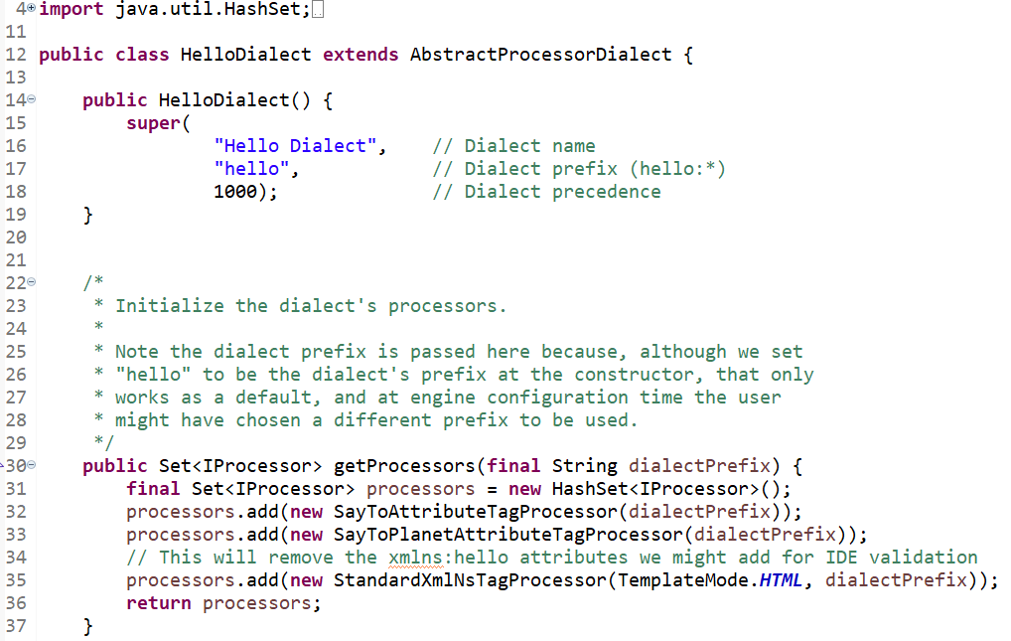
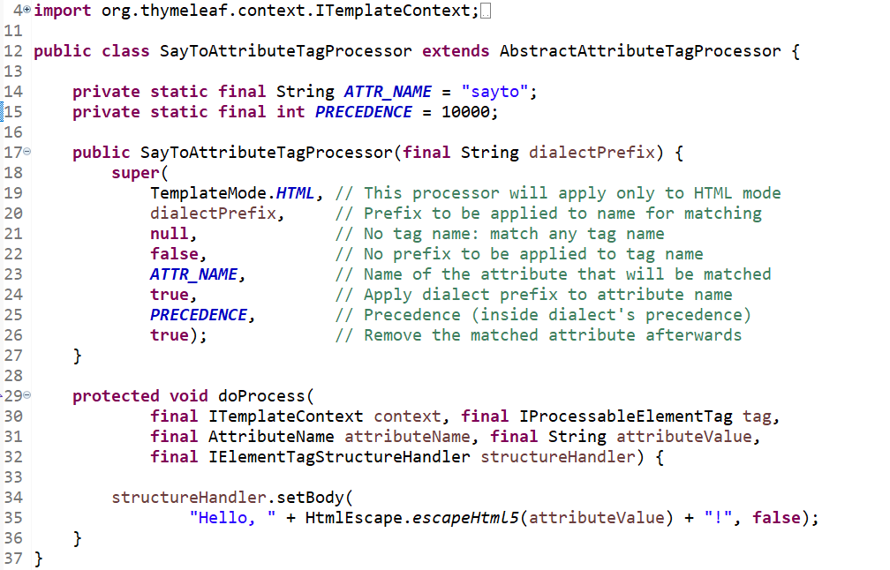
The Standard Dialect

Slide 28
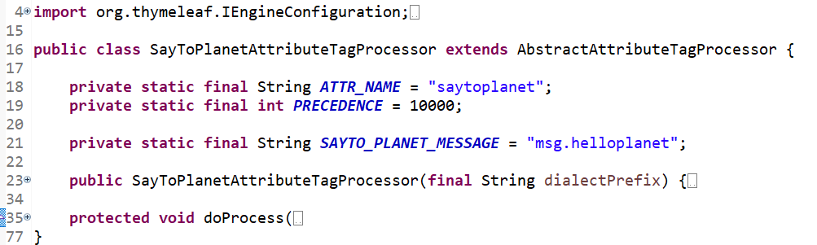
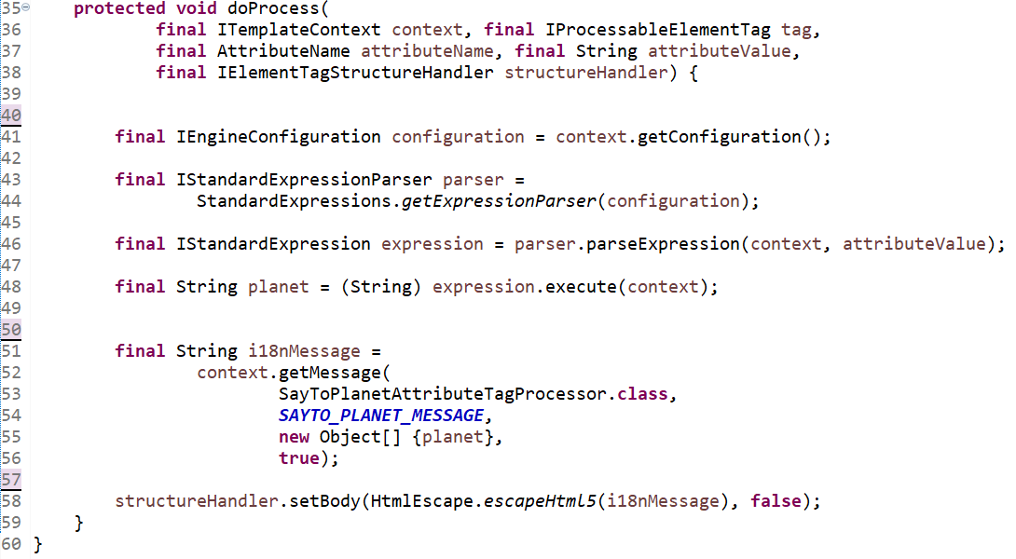
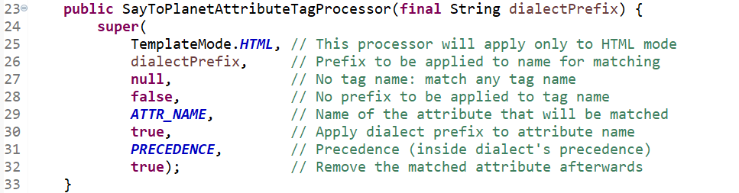
Attribute Tag Processor

Slide 29
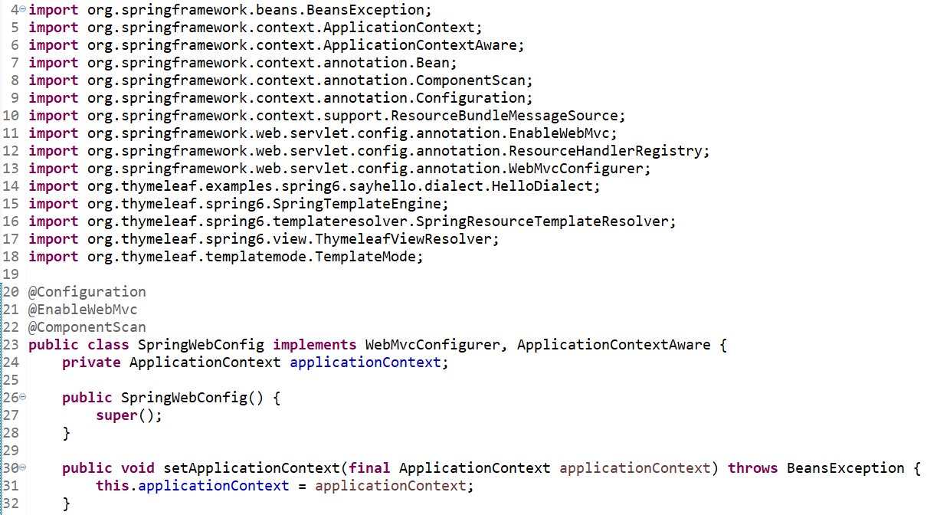
Spring Web Configuration

Slide 30
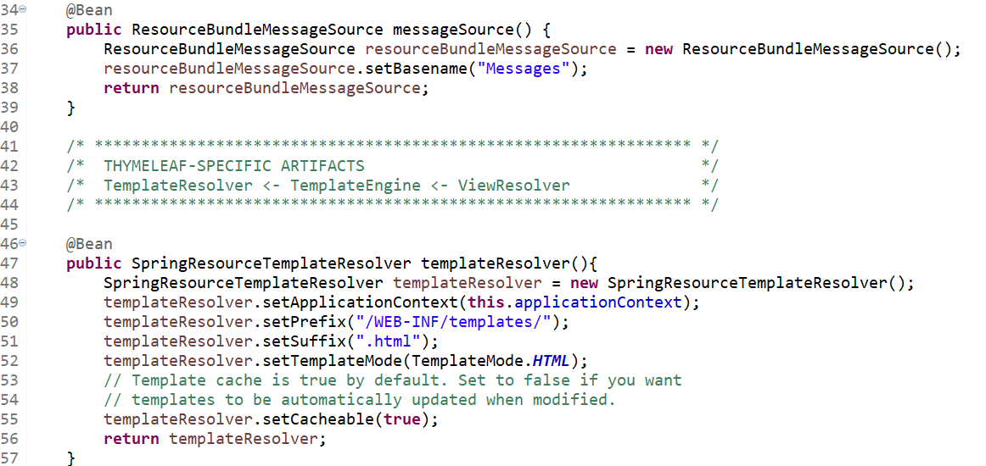
Spring Web Configuration

Slide 31
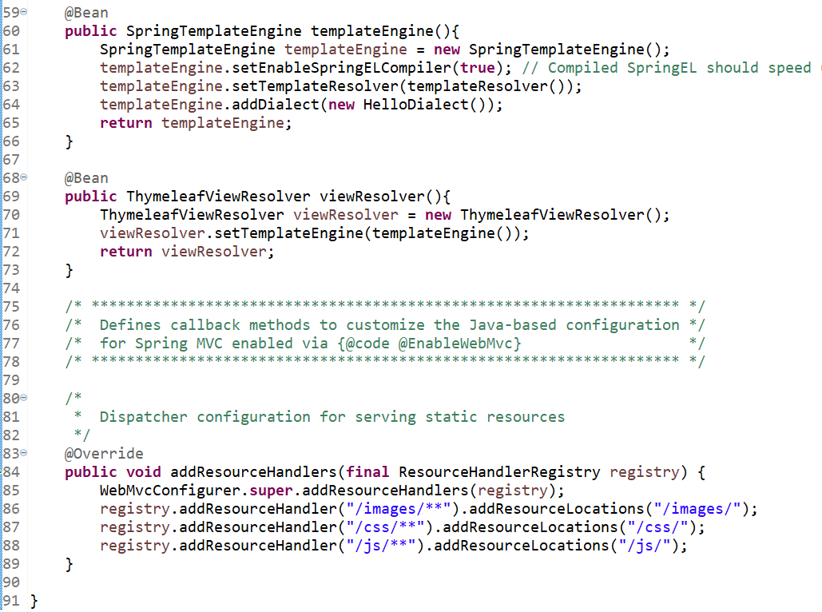
Spring Web Configuration

Slide 32
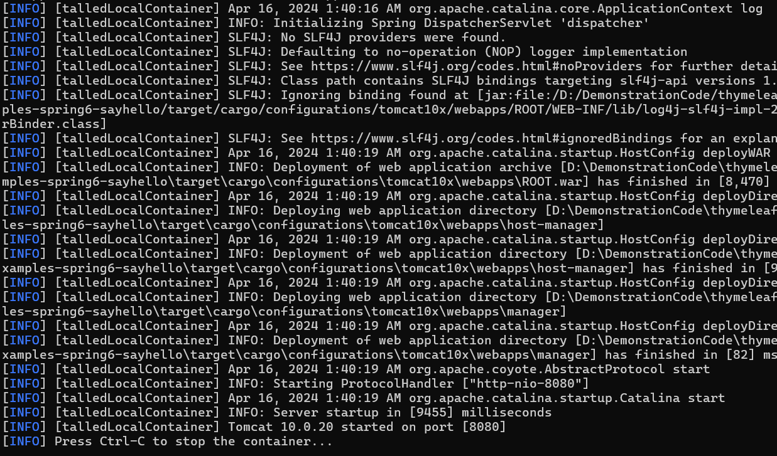
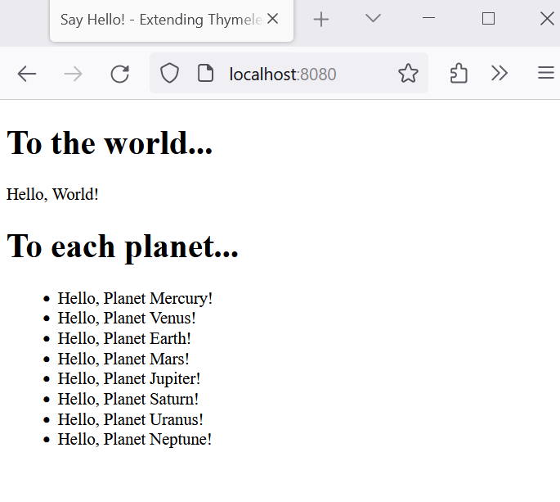
Run Project

Slide 33
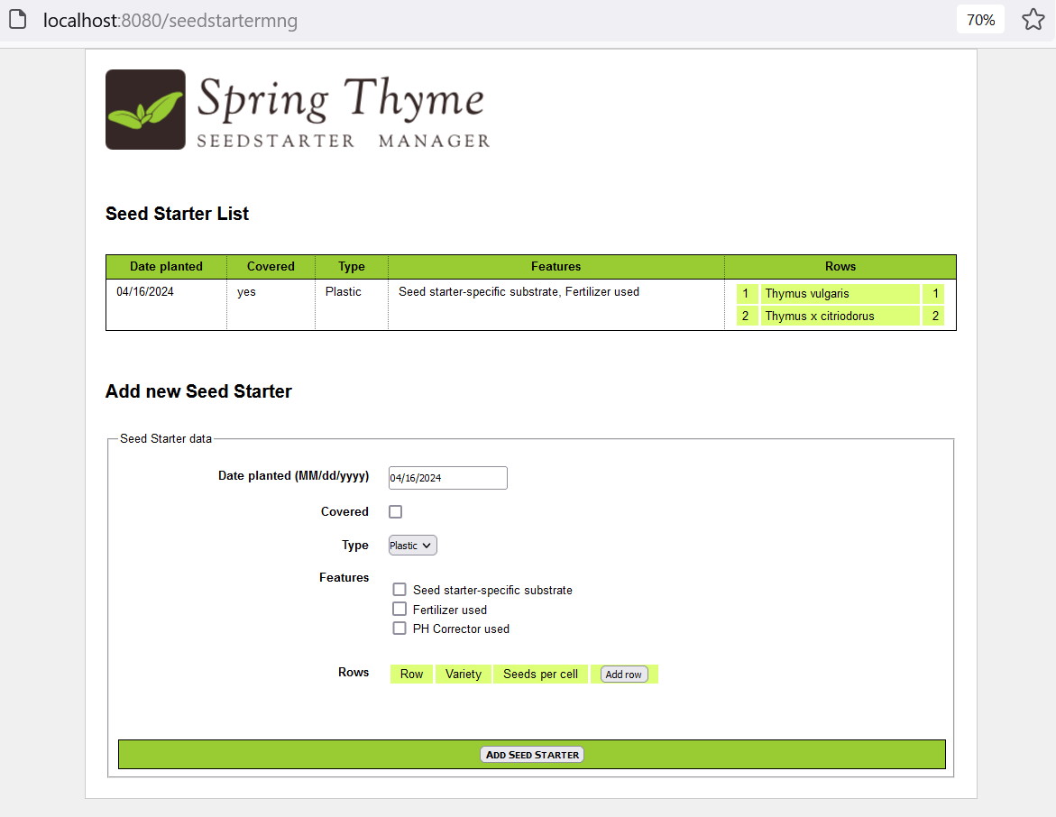
Example: Spring Thyme Seedstarter Manager

Slide 34
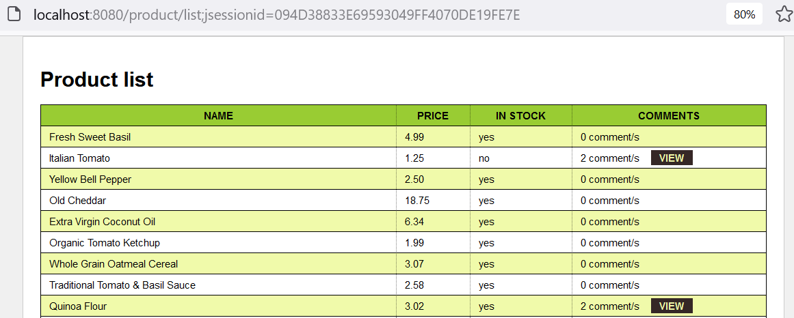
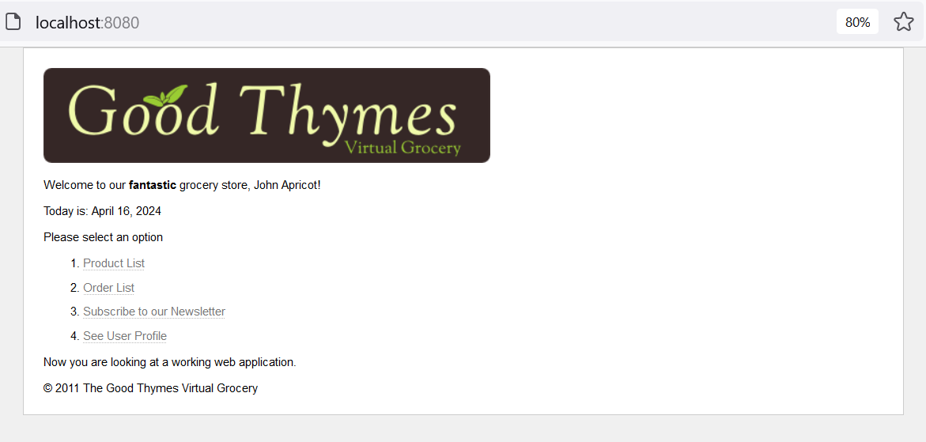
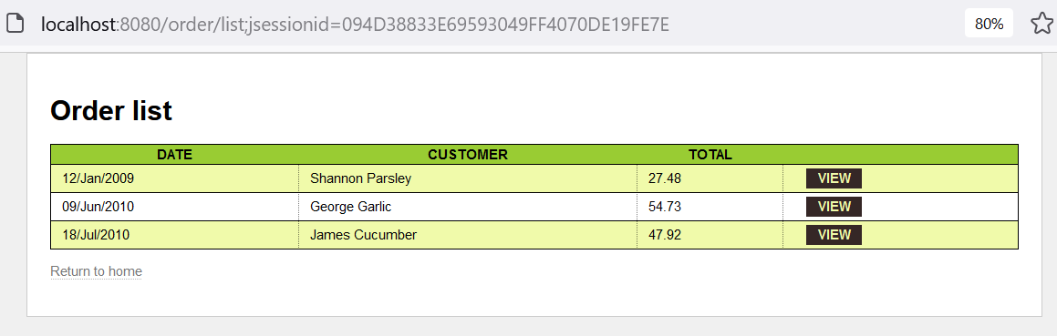
Example:The Good Thymes Virtual Grocery

Slide 35
Summary
Concepts were introduced:
Building web applications using the Spring Framework.
Spring MVC (Model-View-Controller)
Spring WebFlux
Spring Boot
RESTful Web Services
Security, Integration with other technologies
Amodern server-side Java template engine for both web and standalone environments, capable of processing HTML, XML, JavaScript, CSS and even plain text (Thymeleaf)

